Slide 1
DAT502
Journey

Slide 2
W.I.I.F.M.

Slide 3
Databases –
What are they?
Where did they come from?
What do they do for us?
Why are they important?

Slide 4
TERMS
Entity
Table/file
Field/Attribute
Record (tuple)
Notes:
Entity = An entity is a person, place, thing, or event for which data is collected and maintained.
Table/file = data is organised into tables or files. They contain a set of related records that store data about a specific entity. They are shown as 2D structures that consist of vertical columns and horizontal rows. Each column represents a field or characteristic of the entity and each row represents a record, which is an individual instance, or occurrence of the entity
Field / Attribute = a single characteristic or fact about an entity
Record (tuple) = A set of related fields that describes one instance or occurrence of an entity, such as one customer.

Slide 5
Keys
Primary Key
Foreign Key
Candidate key/ Composite Key
Notes:
Primary Key – Field or combination of fields the uniquely identifies a particular member of an entity. Example – Customer table – Customer number = PK
Foreign Key – It forms the relationship between two tables. The Primary Key of the parent table is used as a Foreign Key in the child table to show the relationship/link between the two
Candidate Key – Sometimes there is a choice of fields of field combinations to use a primary key. Any field that can serve as a primary key is called a candidate key.

Slide 6
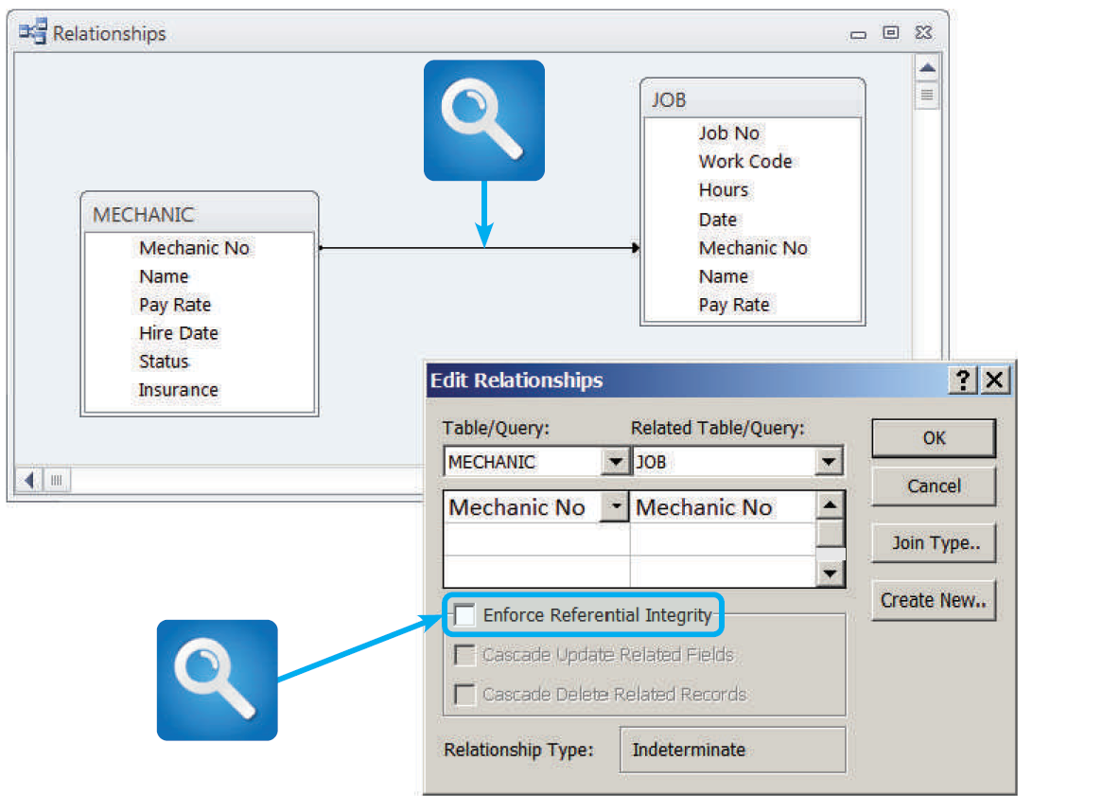
Referential Integrity
A set of rules that avoids data inconsistency and quality problems. In a relational database it means that a FK value cannot be entered into one table unless it matches an existing PK in another.
e.g. Referential Integrity would prevent a customer order from being entered in an order table unless that customer already exists.

Slide 7
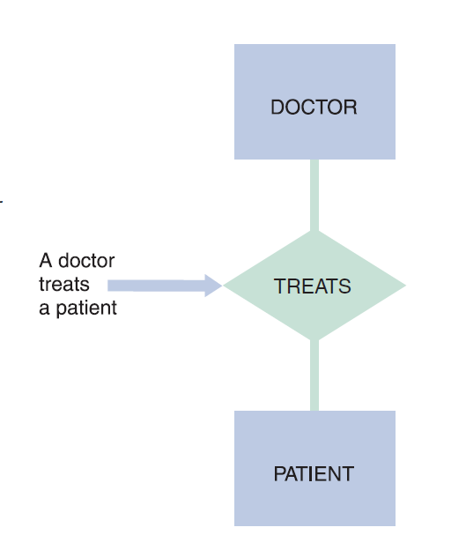
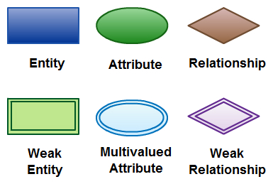
Data Modelling
Conceptual Data Model

Slide 8
FEATURE | CONCEPTUAL | LOGICAL | PHYSICAL
Entity Names | ☑ | ☑
Entity Relationships | ☑ | ☑
Attributes | ☑ | ☑
Primary Keys |  | ☑ | ☑
Foreign Keys |  | ☑ | ☑
Tables Names |  |  | ☑
Column Names |  |  | ☑
Column Data Types |  |  | ☑

Slide 9
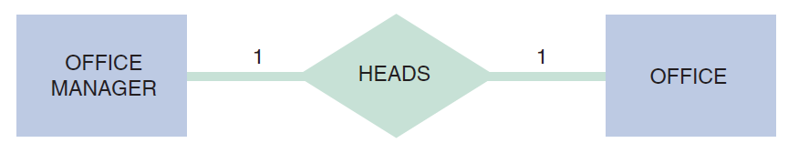
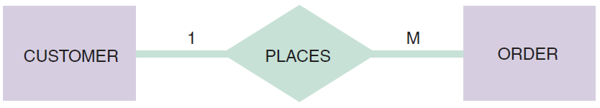
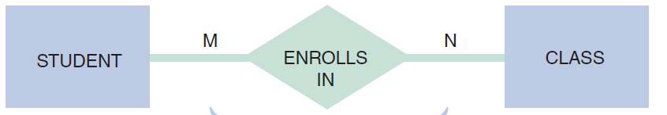

Slide 10
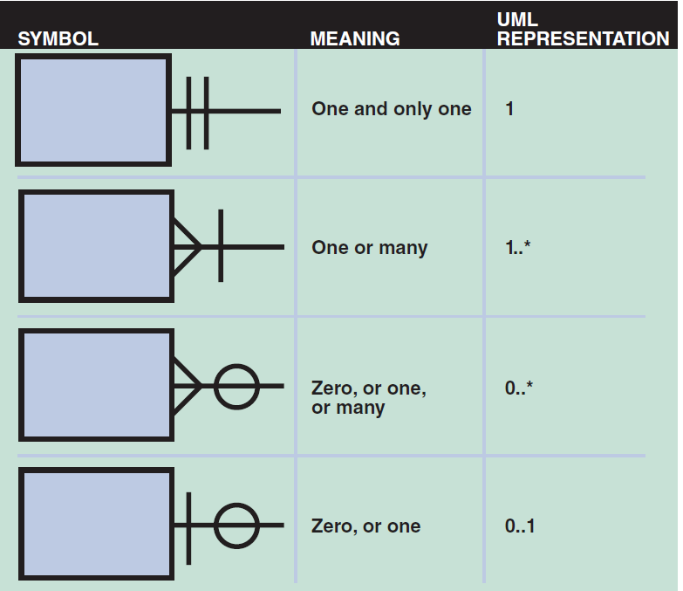
Cardinality – describes the numeric relationship between two entities and shows how many instances of one entity relates to instances of another entity

Slide 11
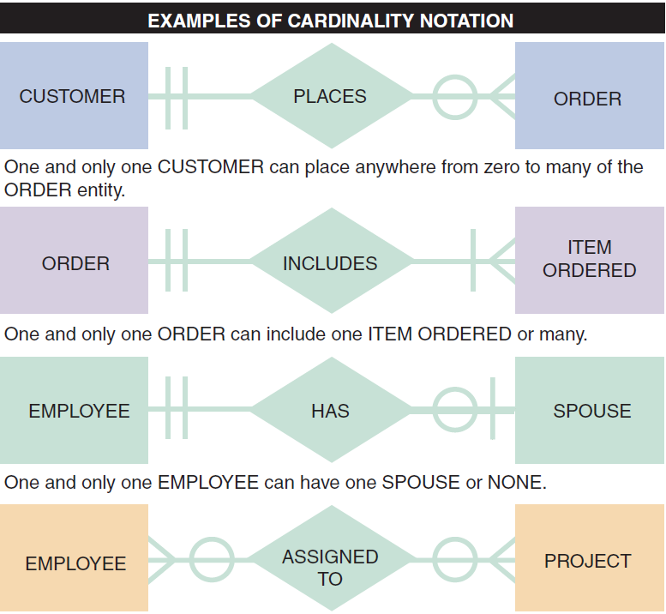

Slide 12
Normalisation
Process in which we organise a database into tables and columns. The idea is that a table should be about a specific topic and that only those columns which support that topic are included.
Limiting the table to one purpose you reduce the number of duplicate data that is contained within the database
UNF – Table design that contains a repeating group

Slide 13
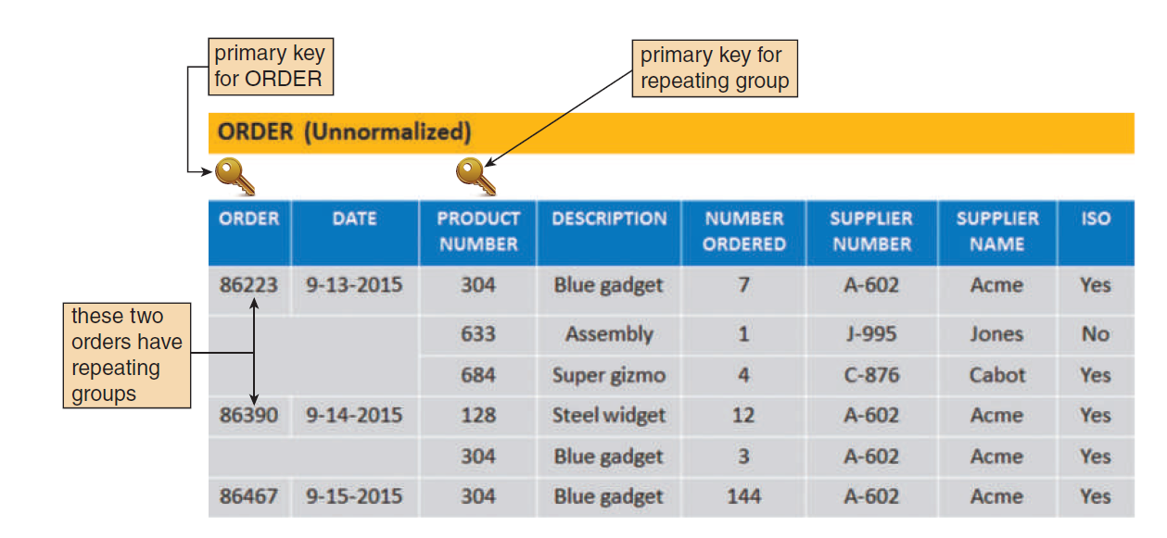

Slide 14
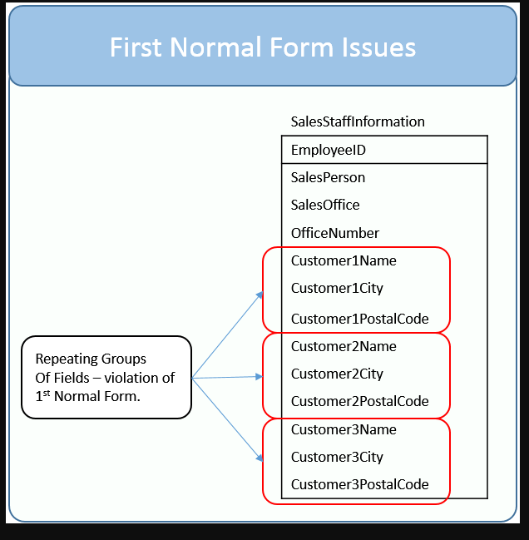
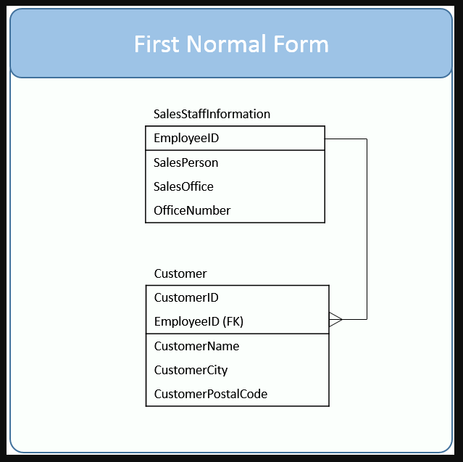
1NF = table is in first normal form if it has no repeating groups and there is a unique/pk noted

Slide 15
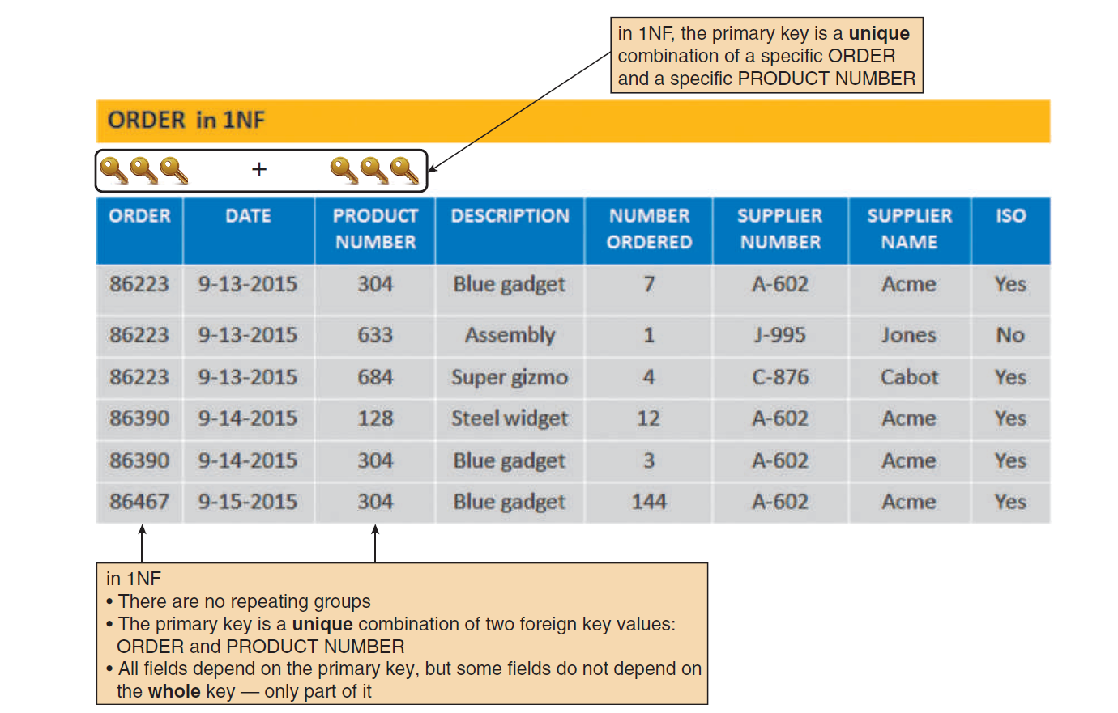

Slide 16
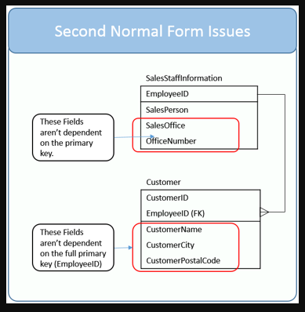
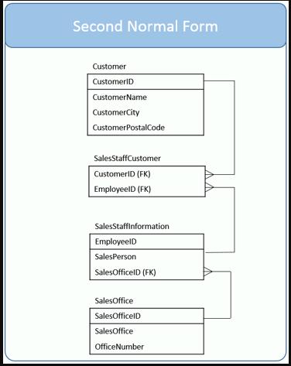
2NF = Table is in second normal form if it is already in first normal form and all the non key columns are dependent of the tables primary key

Slide 17
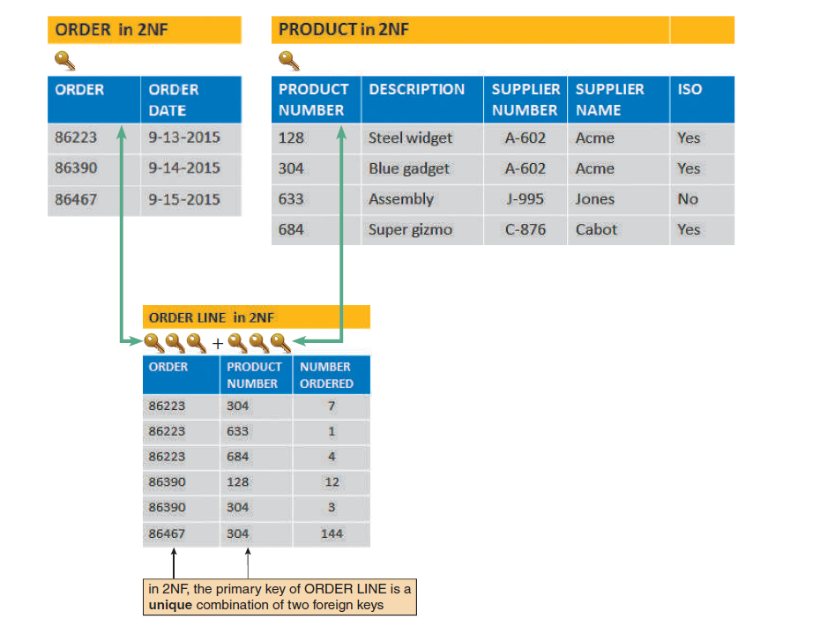

Slide 18
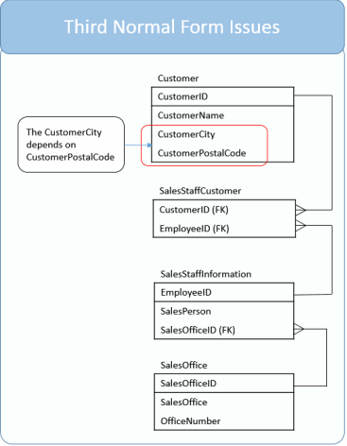
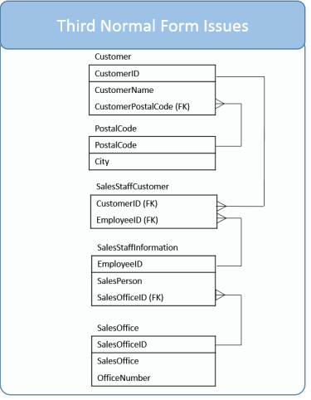
3NF = Table is in third normal form if it is in second normal form and it contains only columns that dependent on the key, whole key and nothing but the key.

Slide 19
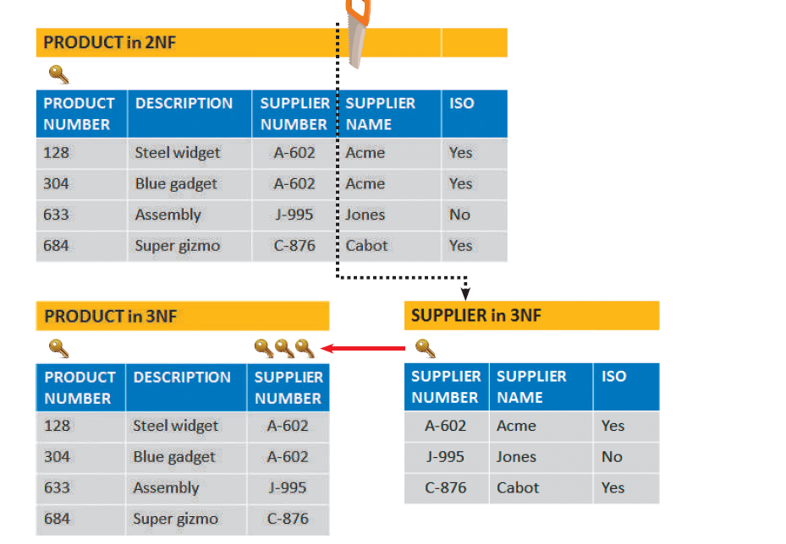

Slide 20
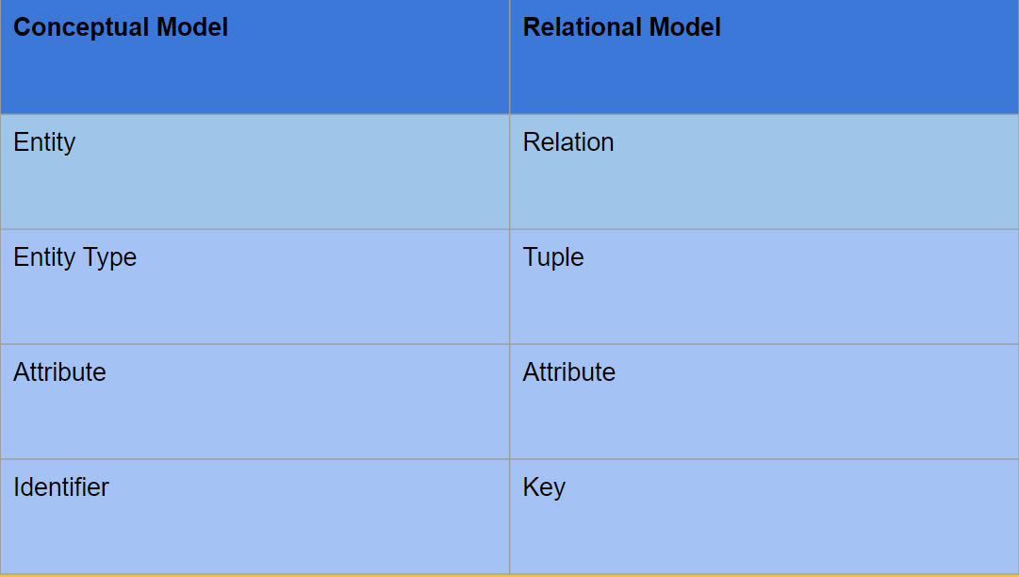
Logical Data Modelling
Notes:
Helps to define the detailed structure of the data elements in a system and the relationships between data elements

Slide 21
Logical Model is Relational
Database is a set of Tables
Tables = Relations (of logical Model)
Relational Model (after normalisation) will be implemented as a set of tables and columns in a DBMS
Entity Relational Diagram (ERD) helps us to visualise data requirements of an information system
ERD is for a non0technical audience
Logical Model helps us to visualise physical data model
Logical Model for technical audience
Normalisation = journey from conceptual to logical

Slide 22
Physical Data Design
Translates the logical data model into a set of SQL statements that define the database
Relation = table
Attribute = column
Key = PK
Relationships are modelled as FK
Datatypes = char, varchar, date, number, bit, Boolean etc.
Constraints – Unique, not null, value within a range

Slide 23
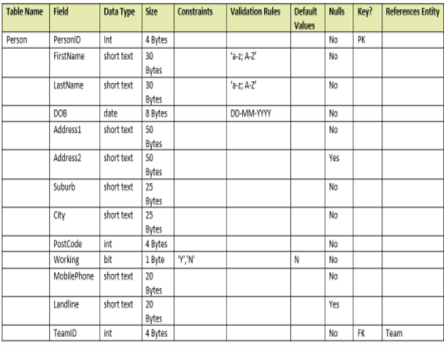
Data Dictionary
Describes the variables of the database.
Sometimes called the Data Definition Matrix

Slide 24
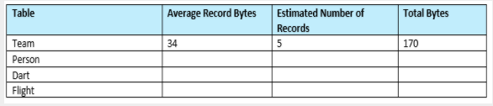
Estimate the size of your database.
This is done using the data dictionary

Slide 25
SQL
Structured Query Language
Used to access or manipulate the data in a relational database
Data Definition Language (DDL) = CREATE table, DROP table, ALTER table statements
Data Manipulation Language (DML) = SELECT, INSERT, UPDATE, DELETE statements

Slide 26
Data Definition Language (DDL)
CREATE TABLE – SQL
DROP TABLE – SQL
ALTER TABLE– SQL
CREATE TABLE table_name (column_name1 data_type(size), column_name2 data_type(size), column_name3 data_type(size), … ); | CREATE TABLE person ( PersonID int, Last_Name varchar(255) First_Name varchar(255) … );
DROP TABLE table_name | DROP TABLE persons
ALTER TABLE table_name ADD column_name data_type(size); ALTER TABLE table_name DROP COLUMN column_name; ALTER TABLE table_name ALTER COLUMN column_name data_type(size); | ALTER TABLE person ADD Primary_Phone varchar(30);

Slide 27
Data Manipulation Language (DML)
INSERT Statement - SQL
INSERT INTO table_name VALUES (value1, value2, value3, … ); AND INSERT INTO table_name (column1, column2, column3,…) VALUES (value1, value2, value3,… ); | INSERT INTO persons VALUES (1, ‘Smith’, ‘John’, ‘Queen St’, ’Auckland’); INSERT INTO persons (personid, last_name, first_name….) VALUES (1, ‘Smith’, ‘John’…); INSERT INTO persons (last_name, first_name, city) VALUES (‘Smith’, ‘John’, ‘Auckland’);

Slide 28
DML
DELETE Statement – SQL
UPDATE Statement – SQL
DELETE * FROM table_name; (delete all records in table) AND DELETE * FROM table_name WHERE some_column=some_value; (delete specific records matching a condition) | DELETE FROM person; DELETE FROM person WHERE id=1;
UPDATE table_name SET column1=value1, column2=value2 WHERE some_column=some_value; | UPDATE person SET address=‘Hardy St’, city =‘Nelson’ WHERE id=1;

Slide 29
SELECT statement – SQL
The SELECT statement retrieves data from a database.
The data is returned in a table-like structure called a result-set.
SELECT is the most frequently used action on a database.
SELECT * FROM table_name; AND SELECT column_name FROM table_name; | SELECT * FROM person; SELECT First_Name, Last_Name FROM person;
SELECT DISTINCT = The SELECT DISTINCT statement is used to return only different values and therefore no duplicates
SELECT DISTINCT column_name1, column_name2…. FROM table_name;

Slide 30
SELECT TOP – SQL
The SELECT TOP statement returns a specified number of records.
SELECT TOP is useful when working with very large datasets.
Non SQL Server databases use keywords like LIMIT, OFFSET, and ROWNUM.
SELECT TOP I column-names FROM table-name; | SELECT TOP 10 Id, ProductName, UnitPrice, Package FROM Product ORDER BY UnitPrice DESC;
Problem: List top 10 most expensive products

Slide 31
MIN and MAX – SQL
SELECT MIN returns the minimum value for a column.
SELECT MAX returns the maximum value for a column.
SELECT MIN(column-name) FROM table-name; SELECT MAX(column-name) FROM table-name; | SELECT MIN(UnitPrice) FROM Product; SELECT MAX(TotalAmount) FROM [Order] WHERE YEAR(OrderDate) = 2014; SELECT MAX(OrderDate) FROM [Order] WHERE YEAR(OrderDate) = 2013;

Slide 32
COUNT, SUM and AVG- SQL
SELECT COUNT returns a count of the number of data values.
SELECT SUM returns the sum of the data values.
SELECT AVG returns the average of the data values.
SELECT COUNT(column-name) FROM table-name; SELECT SUM(column-name) FROM table-name; SELECT AVG(column-name) FROM table-name; | SELECT COUNT(Id) FROM Customer; SELECT SUM(TotalAmount) FROM [Order] WHERE YEAR(OrderDate) = 2013; SELECT AVG(TotalAmount) FROM [Order];

Slide 33
WHERE clause – SQL
To limit the number of rows use the WHERE clause.
The WHERE clause filters for rows that meet certain criteria.
WHERE is followed by a condition that returns either true or false.
WHERE is used with SELECT, UPDATE, and DELETE.
SELECT column-names FROM table-name WHERE condition; UPDATE table-name SET column-name = value WHERE condition; DELETE table-name WHERE condition; | SELECT Id, FirstName, LastName, City, Country, Phone FROM Customer WHERE Country = 'Sweden’; UPDATE Supplier SET City = 'Sydney' WHERE Name = 'Pavlova, Ltd.’; DELETE FROM Product WHERE UnitPrice > 50;

Slide 34
ORDER BY clause – SQL
SELECT returns records in no particular order.
To ensure a specific order use the ORDER BY clause.
ORDER BY allows sorting by one or more columns.
Records can be returned in ascending or descending order.
SELECT column-names FROM table-name WHERE condition ORDER BY column-names; | SELECT CompanyName, ContactName, City, Country FROM Supplier ORDER BY CompanyName; SELECT CompanyName, ContactName, City, Country FROM Supplier ORDER BY CompanyName DESC;
This will list all the suppliers in reverse order

Slide 35
AND, OR, NOT clause – SQL
WHERE conditions can be combined with AND, OR, and NOT.
A WHERE clause with AND requires that two conditions are true.
A WHERE clause with OR requires that one of two conditions is true.
A WHERE clause with NOT negates the specified condition.

Slide 36
SELECT column-names FROM table-name WHERE condition1 AND condition2; UPDATE table-name SET column-name = value WHERE condition1 OR condition2; DELETE table-name WHERE NOT condition; | SELECT Id, FirstName, LastName, City, Country FROM Customer WHERE FirstName = 'Thomas' AND LastName = 'Hardy’; SELECT Id, FirstName, LastName, City, Country FROM Customer WHERE Country = 'Spain' OR Country = 'France’; SELECT Id, FirstName, LastName, City, Country FROM Customer WHERE NOT Country = 'USA’; SELECT Id, OrderDate, CustomerId, TotalAmount FROM [Order] WHERE NOT (TotalAmount >= 50 AND TotalAmount <= 15000) ORDER BY TotalAmount DESC
Problem: List all orders that not between $50 and $15000

Slide 37
BETWEEN – SQL
WHERE BETWEEN returns values that fall within a given range.
WHERE BETWEEN is a shorthand for >= AND <=.
BETWEEN operator is inclusive: begin and end values are included.
SELECT column-names FROM table-name WHERE column-name BETWEEN value1 AND value2; | SELECT Id, ProductName, UnitPrice FROM Product WHERE UnitPrice BETWEEN 10 AND 20 ORDER BY UnitPrice;

Slide 38
IN – SQL
WHERE IN returns values that matches values in a list or subquery.
WHERE IN is a shorthand for multiple OR conditions.
SELECT column-names FROM table-name WHERE column-name IN (values) ; | SELECT Id, CompanyName, City, Country FROM Supplier WHERE Country IN ('USA', 'UK', 'Japan’); SELECT Id, ProductName, UnitPrice FROM Product WHERE UnitPrice NOT IN (10,20,30,40,50); SELECT Id, FirstName, LastName, Country FROM Customer WHERE Country IN (SELECT Country FROM Supplier);
Problem: List all customers that are from the same countries as the suppliers.

Slide 39
LIKE – SQL
WHERE LIKE determines if a character string matches a pattern.
Use WHERE LIKE when only a fragment of a text value is known.
WHERE LIKE supports two wildcard match options: % and _.
FYI – in MS ACCESS you can also use * for a wildcard
SELECT column-names FROM table-name WHERE column-name LIKE value | SELECT Id, ProductName, UnitPrice, Package FROM Product WHERE ProductName LIKE 'Ca%’ SELECT Id, ProductName, UnitPrice, Package FROM Product WHERE ProductName LIKE 'Cha_' OR ProductName LIKE 'Chan_'

Slide 40
GROUP BY clause – SQL
The GROUP BY clause groups records into summary rows.
GROUP BY returns one records for each group.
GROUP BY typically also involves aggregates: COUNT, MAX, SUM, AVG, etc.
GROUP BY can group by one or more columns.
SELECT column-names FROM table-name WHERE condition GROUP BY column-names; SELECT column-names FROM table-name WHERE condition GROUP BY column-names ORDER BY column-names; | SELECT COUNT(Id), Country FROM Customer GROUP BY Country; SELECT COUNT(Id), Country FROM Customer GROUP BY Country ORDER BY COUNT(Id) DESC; SELECT SUM(O.TotalPrice), C.FirstName, C.LastName FROM [Order] O JOIN Customer C ON O.CustomerId = C.Id GROUP BY C.FirstName, C.LastName ORDER BY SUM(O.TotalPrice) DESC;
Problem: List the total amount ordered for each customer

Slide 41
HAVING clause – SQL
HAVING filters records that work on summarized GROUP BY results.
HAVING applies to summarized group records, whereas WHERE applies to individual records.
Only the groups that meet the HAVING criteria will be returned.
HAVING requires that a GROUP BY clause is present.
WHERE and HAVING can be in the same query.

Slide 42
SELECT column-names FROM table-name WHERE condition GROUP BY column-names HAVING condition; SELECT column-names FROM table-name WHERE condition GROUP BY column-names HAVING condition ORDER BY column-names; | SELECT COUNT(Id), Country FROM Customer GROUP BY Country HAVING COUNT(Id) > 10; SELECT COUNT(Id), Country FROM Customer WHERE Country <> 'USA' GROUP BY Country HAVING COUNT(Id) >= 9 ORDER BY COUNT(Id) DESC; SELECT AVG(TotalAmount), FirstName, LastName FROM [Order] O JOIN Customer C ON O.CustomerId = C.Id GROUP BY FirstName, LastName HAVING AVG(TotalAmount) BETWEEN 1000 AND 1200;
Problem: List all customer with average orders between $1000 and $1200.

Slide 43
SQL Alias
An Alias is a shorthand for a table or column name.
Aliases reduce the amount of typing required to enter a query.
Complex queries with aliases are generally easier to read.
Aliases are useful with JOINs and aggregates: SUM, COUNT, etc.
An Alias only exists for the duration of the query.
SELECT column-name AS alias-name FROM table-name alias-name WHERE condition; | SELECT COUNT(C.Id) AS TotalCustomers, C.Country AS Nation FROM Customer C GROUP BY C.Country; SELECT C.Id AS Identifier, C.LastName + ', ' + C.FirstName AS CustomerName, SUM(O.TotalAmount) AS TotalSpent FROM [Order] O JOIN Customer C ON O.CustomerId = C.Id GROUP BY C.Id, C.LastName + ', ' + C.FirstName ORDER BY TotalSpent DESC;
Problem: List the total amount ordered by customer with easy to read column headers

Slide 44
The aliases significantly simplify writing the JOIN and ORDER BY clauses. The C alias in C.Id helps identify the Customer Id rather then the Order Id.
Identifier | CustomerName | TotalSpent
63 | Kloss, Horst | 117483.39
71 | Pavarotti, Jose | 115673.39
20 | Mendel, Roland | 113236.68
37 | McKenna, Patricia | 57317.39
65 | Wilson, Paula | 52245.90

Slide 45
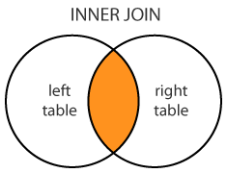
INNER JOIN
JOIN – SQL
A SQL JOIN combines records from two tables.
A JOIN locates related column values in the two tables.
A query can contain zero, one, or multiple JOIN operations.
INNER JOIN is the same as JOIN; the keyword INNER is optional.

Slide 46
SELECT column-names FROM table-name1 JOIN table-name2 ON column-name1 = column-name2 WHERE condition; SELECT column-names FROM table-name1 INNER JOIN table-name2 ON column-name1 = column-name2 WHERE condition; | SELECT OrderNumber, TotalAmount, FirstName, LastName, City, Country FROM [Order] JOIN Customer ON [Order].CustomerId = Customer.Id; SELECT O.OrderNumber, CONVERT(date,O.OrderDate) AS Date, P.ProductName, I.Quantity, I.UnitPrice FROM [Order] O JOIN OrderItem I ON O.Id = I.OrderId JOIN Product P ON P.Id = I.ProductId ORDER BY O.OrderNumber Problem: List all orders with product names, quantities, and prices This query performs two JOIN operations with 3 tables. The O, I, and P are table aliases. Date is a column alias.

Slide 47
LEFT JOIN
LEFT JOIN – SQL
LEFT JOIN performs a join starting with the first (left-most) table and then any matching second (right-most) table records.
LEFT JOIN and LEFT OUTER JOIN are the same.
LEFT TABLE
RIGHT TABLE
SELECT column-names FROM table-name1 LEFT JOIN table-name2 ON column-name1 = column-name2 WHERE condition; | SELECT OrderNumber, TotalAmount, FirstName, LastName, City, Country FROM Customer C LEFT JOIN [Order] O ON O.CustomerId = C.Id ORDER BY TotalAmount;
This will list all customers, whether they placed any order or not. The ORDER BY TotalAmount shows the customers without orders first (i.e. TotalAmount is NULL).

Slide 48
RIGHT JOIN – SQL
RIGHT JOIN performs a join starting with the second (right-most) table and then any matching first (left-most) table records.
RIGHT JOIN and RIGHT OUTER JOIN are the same.
RIGHT JOIN
LEFT TABLE
RIGHT TABLE
SELECT column-names FROM table-name1 RIGHT JOIN table-name2 ON column-name1 = column-name2 WHERE condition; SELECT column-names FROM table-name1 RIGHT OUTER JOIN table-name2 ON column-name1 = column-name2 WHERE condition; | SELECT TotalAmount, FirstName, LastName, City, Country FROM [Order] O RIGHT JOIN Customer C ON O.CustomerId = C.Id WHERE TotalAmount IS NULL;
This returns customers that, when joined, have no matching order.

Slide 49
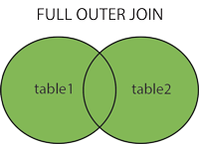
FULL JOIN – SQL
FULL JOIN returns all matching records from both tables whether the other table matches or not.
FULL JOIN can potentially return very large datasets.
FULL JOIN and FULL OUTER JOIN are the same.

Slide 50
SELECT column-names FROM table-name1 FULL JOIN table-name2 ON column-name1 = column-name2 WHERE condition; SELECT column-names FROM table-name1 FULL OUTER JOIN table-name2 ON column-name1 = column-name2 WHERE condition; | SELECT C.FirstName, C.LastName, C.Country AS CustomerCountry, S.Country AS SupplierCountry, S.CompanyName FROM Customer C FULL JOIN Supplier S ON C.Country = S.Country ORDER BY C.Country, S.Country;
This returns suppliers that have no customers in their country, and customers that have no suppliers in their country, and customers and suppliers that are from the same country.

Slide 51
SELF JOIN – SQL
A self JOIN occurs when a table takes a 'selfie'.
A self JOIN is a regular join but the table is joined with itself.
This can be useful when modeling hierarchies.
They are also useful for comparisons within a table.
SELECT column-names FROM table-name T1 JOIN table-name T2 WHERE condition; | SELECT B.FirstName AS FirstName1, B.LastName AS LastName1, A.FirstName AS FirstName2, A.LastName AS LastName2, B.City, B.Country FROM Customer A, Customer B WHERE A.Id <> B.Id AND A.City = B.City AND A.Country = B.Country ORDER BY A.Country;
Problem: Match customers that are from the same city and country

Slide 52
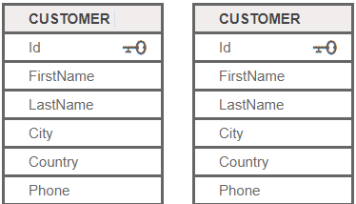
FirstName1 | LastName1 | FirstName2 | LastName2 | City | Country
Patricio | Simpson | Yvonne | Moncada | Buenos Aires | Argentina
Patricio | Simpson | Sergio | Gutiérrez | Buenos Aires | Argentina
Yvonne | Moncada | Patricio | Simpson | Buenos Aires | Argentina
Yvonne | Moncada | Sergio | Gutiérrez | Buenos Aires | Argentina
Sergio | Gutiérrez | Patricio | Simpson | Buenos Aires | Argentina
Sergio | Gutiérrez | Yvonne | Moncada | Buenos Aires | Argentina
Anabela | Domingues | Lúcia | Carvalho | Sao Paulo | Brazil
Anabela | Domingues | Aria | Cruz | Sao Paulo | Brazil
Anabela | Domingues | Pedro | Afonso | Sao Paulo | Brazil
Bernardo | Batista | Janete | Limeira | Rio de Janeiro | Brazil
Bernardo | Batista | Mario | Pontes | Rio de Janeiro | Brazil
Lúcia | Carvalho | Anabela | Domingues | Sao Paulo | Brazil
Lúcia | Carvalho | Aria | Cruz | Sao Paulo | Brazil
Lúcia | Carvalho | Pedro | Afonso | Sao Paulo | Brazil
Janete | Limeira | Bernardo | Batista | Rio de Janeiro | Brazil
Janete | Limeira | Mario | Pontes | Rio de Janeiro | Brazil

Slide 53
UNION clause – SQL
UNION combines the result sets of two queries.
Column data types in the two queries must match.
UNION combines by column position rather than column name.
Result set 1
Result set 2

Slide 54
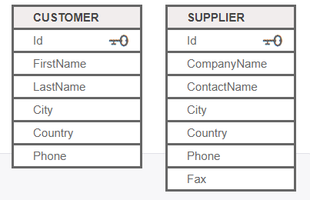
SELECT column-names FROM table-name UNION SELECT column-names FROM table-name; | SELECT 'Customer' As Type, FirstName + ' ' + LastName AS ContactName, City, Country, Phone FROM Customer UNION SELECT 'Supplier', ContactName, City, Country, Phone FROM Supplier;
Problem: List all contacts, i.e., suppliers and customers.

Slide 55
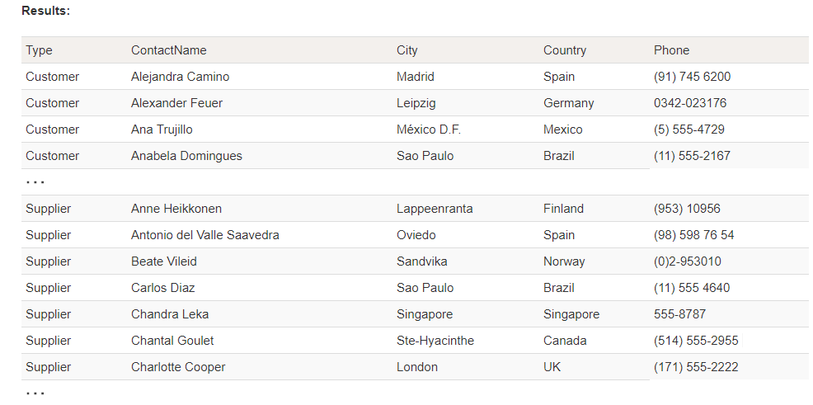

Slide 56
Subqueries – SQL
A subquery is a SQL query within a query.
Subqueries are nested queries that provide data to the enclosing query.
Subqueries can return individual values or a list of records
Subqueries must be enclosed with parenthesis
SELECT column-names FROM table-name1 WHERE value IN (SELECT column-name FROM table-name2 WHERE condition); SELECT column1 = (SELECT column-name FROM table-name WHERE condition), column-names FROM table-name WEHRE condition; | SELECT ProductName FROM Product WHERE Id IN (SELECT ProductId FROM OrderItem WHERE Quantity > 100); SELECT FirstName, LastName, OrderCount = (SELECT COUNT(O.Id) FROM [Order] O WHERE O.CustomerId = C.Id) FROM Customer C ;
Problem: List products with order quantities greater than 100.
Problem: List all customers with their total number of orders. This is a correlated subquery because the subquery references the enclosing query (i.e. the C.Id in the WHERE clause).

Slide 57
ANY, ALL – SQL
ANY and ALL keywords are used with a WHERE or HAVING clause.
ANY and ALL operate on subqueries that return multiple values.
ANY returns true if any of the subquery values meet the condition.
ALL returns true if all of the subquery values meet the condition.
SELECT column-names FROM table-name WHERE column-name operator ANY (SELECT column-name FROM table-name WHERE condition); SELECT column-names FROM table-name WHERE column-name operator ALL (SELECT column-name FROM table-name WHERE condition); | SELECT ProductName FROM Product WHERE Id = ANY (SELECT ProductId FROM OrderItem WHERE Quantity = 1); SELECT DISTINCT FirstName + ' ' + LastName as CustomerName FROM Customer, [Order] WHERE Customer.Id = [Order].CustomerId AND TotalAmount > ALL (SELECT AVG(TotalAmount) FROM [Order] GROUP BY CustomerId);
Problem: Which products were sold by the unit (i.e. quantity = 1)
Problem: List customers who placed orders that are larger than the average of each customer order

Slide 58
EXISTS – SQL
WHERE EXISTS tests for the existence of any records in a subquery.
EXISTS returns true if the subquery returns one or more records.
EXISTS is commonly used with correlated subqueries.
SELECT column-names FROM table-name WHERE EXISTS (SELECT column-name FROM table-name WHERE condition); | SELECT CompanyName FROM Supplier WHERE EXISTS (SELECT ProductName FROM Product WHERE SupplierId = Supplier.Id AND UnitPrice > 100) ;
Problem: Find suppliers with products over $100.
s a correlated subquery because the subquery references the enclosing query (with Supplier.Id).

Slide 59
NULL clause – SQL
NULL is a special value that signifies 'no value'.
Comparing a column to NULL using the = operator is undefined.
Instead, use WHERE IS NULL or WHERE IS NOT NULL.
SELECT column-names FROM table-name WHERE column-name IS NULL; SELECT column-names FROM table-name WHERE column-name IS NOT NULL; | SELECT Id, CompanyName, Phone, Fax FROM Supplier WHERE Fax IS NULL; SELECT Id, CompanyName, Phone, Fax FROM Supplier WHERE Fax IS NOT NULL;

Slide 60
Forms
Allow you to create a User Interface in which you can enter and edit data.
It controls how users interact with the database. Therefore you can limit what users can see and interact with
Reports
This is how you format, summarize and present the data
Usually answers a specific question
Can be run at any time and will reflect the current data.

Slide 61
How to create FORMS in MS ACCESS
How to create a REPORT in MS Access Part 1
How to create a REPORT in MS Access Part 2

Slide 62
Indexes
Indexes are used to retrieve data from the database very fast. The users cannot see the indexes, they are just used to speed up searches/queries.
Avoid using indexes when:
Indexes should not be used on small tables.
Tables that have frequent, large batch updates or insert operations.
Indexes should not be used on columns that contain a high number of NULL values.
Columns that are frequently manipulated should not be indexed.

Slide 63
CREATE INDEX index_name ON table_name (column1, column2, ...); CREATE UNIQUE INDEX index_name ON table_name (column1, column2, ...); | CREATE INDEX idx_lastname ON Persons (LastName); CREATE INDEX idx_pname ON Persons (LastName, FirstName);
DROP INDEX index_name ON table_name;
Indexing in MS Access

Slide 64
CONSTRAINTS
Constraints can be specified when the table is created with the CREATE TABLE statement, or after the table is created with the ALTER TABLE statement.
SQL constraints are used to specify rules for the data in a table.
Constraints are used to limit the type of data that can go into a table. This ensures the accuracy and reliability of the data in the table. If there is any violation between the constraint and the data action, the action is aborted.
Constraints can be column level or table level. Column level constraints apply to a column, and table level constraints apply to the whole table.
The following constraints are commonly used in SQL:
NOT NULL - Ensures that a column cannot have a NULL value
UNIQUE - Ensures that all values in a column are different
PRIMARY KEY - A combination of a NOT NULL and UNIQUE. Uniquely identifies each row in a table
FOREIGN KEY - Uniquely identifies a row/record in another table
CHECK - Ensures that all values in a column satisfies a specific condition
DEFAULT - Sets a default value for a column when no value is specified
INDEX - Used to create and retrieve data from the database very quickly

Slide 65


